Slide 1

Module 2: Infection Prevention and Control (IPC)
Standard Precautions, hand hygiene, proper use of PPEs, Cleaning and Biomedical waste management

Slide 2

What are Standard Precautions?
Standard precautions are meant to reduce the risk of transmission of bloodborne and other pathogens from both recognized and unrecognized sources.
They are the basic level of infection control precautions which are to be used, as a minimum, in the care of all patients.

Slide 3
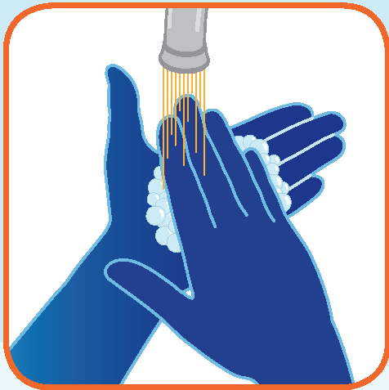
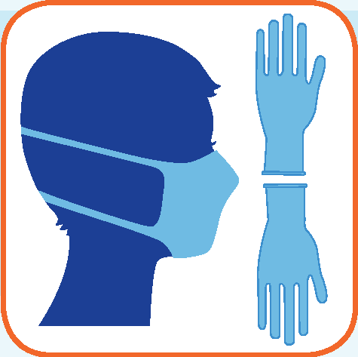

Components of Standard Precautions*
Hand Hygiene
PPE
Respiratory and Cough Etiquette
*epidemic and pandemic alert and response
World Health Organization 2007

Slide 4
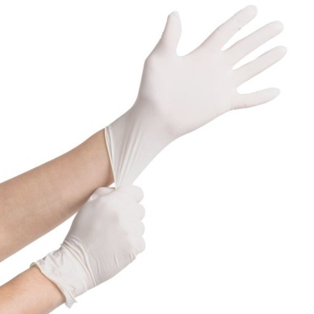
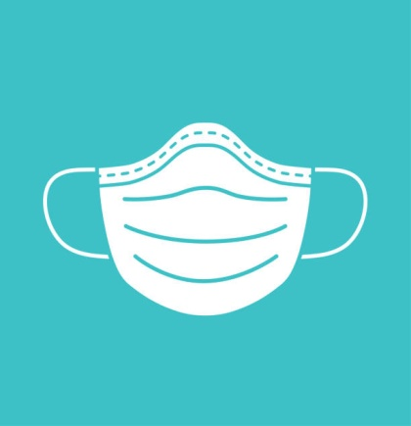



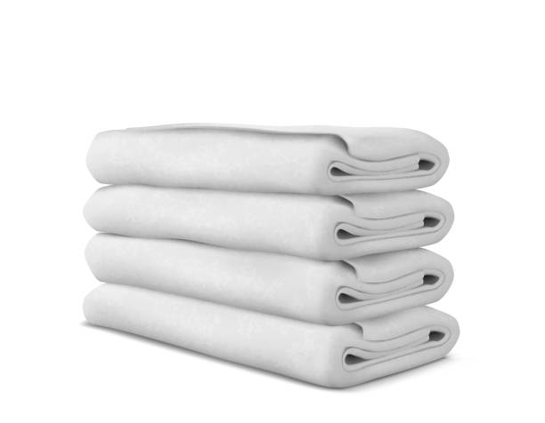
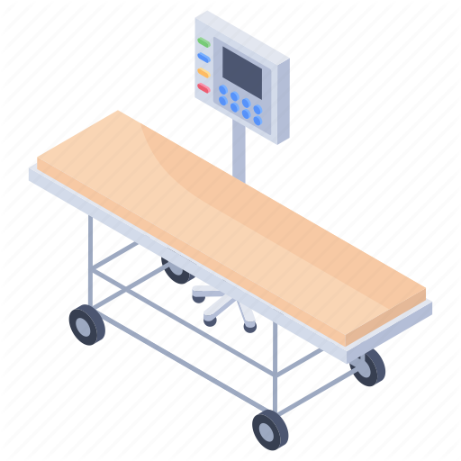
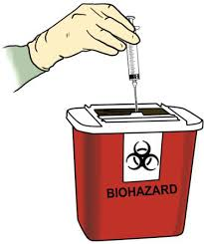
Healthcare facility recommendations for Standard Precautions*
PPE
Hand Hygiene
Gloves
Facial Protection
Gown
Prevention of needle stick and injuries from other sharp instruments
Respiratory Hygiene & Cough Etiquette
Environmental Cleaning
Linen
Waste Disposal
Patient Care Equipment
*epidemic and pandemic alert and response
World Health Organization 2007

Slide 5
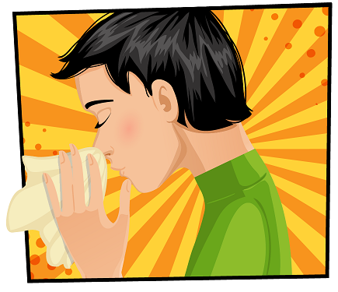
Respiratory Hygiene and Cough Etiquette
Persons with respiratory symptoms should follow source control measures:
  Cover their nose and mouth when coughing/sneezing with tissue or mask
  dispose off used tissues and masks
  perform hand hygiene after contact with respiratory secretions
Health-care facilities should:
  Place acute febrile respiratory symptomatic patients at least 1 metre (3 feet) away from others in common waiting areas, if possible
  Post visual alerts at the entrance to health-care facilities instructing persons with respiratory symptoms to practice respiratory hygiene/cough etiquette
  Make hand hygiene resources, tissues and masks available in common areas and areas used for the evaluation of patients with respiratory illnesses.

Slide 6
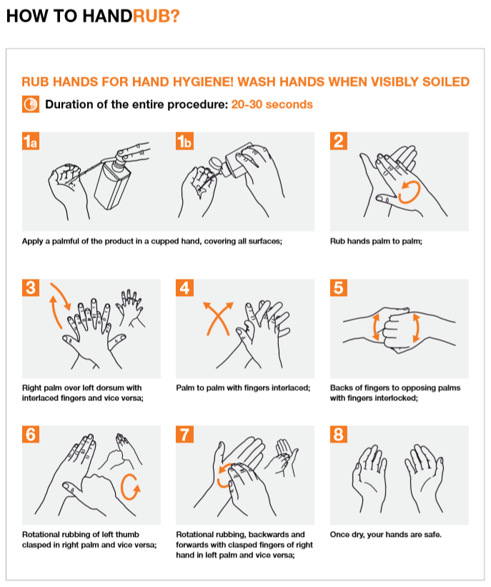
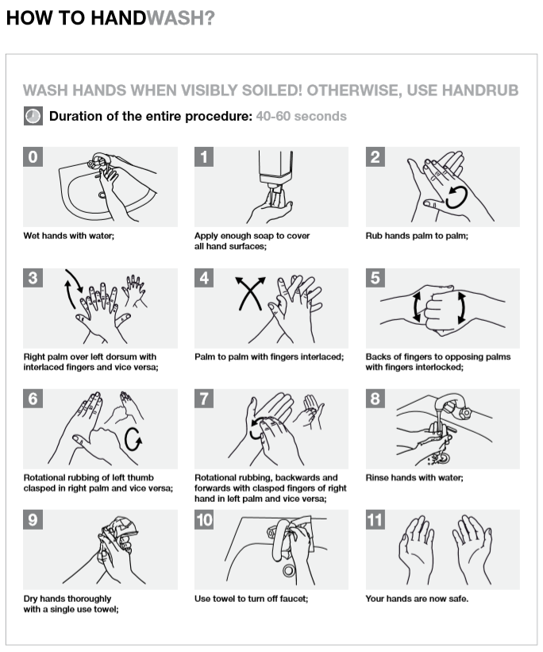
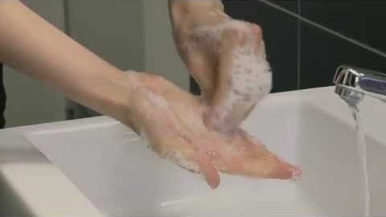

Hand Hygiene:
HandRub (Sanitizer) and HandWash
Video on Handwash
Source: WHO
https://www.who.int/gpsc/5may/Hand_Hygiene_Why_How_and_When_Brochure.pdf?ua=1

Slide 7
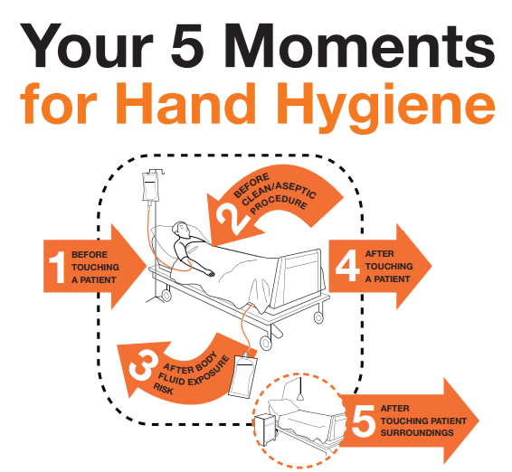
Hand Hygiene: 5 Moments of Hand Hygiene
Before:
  Patient contact
  Donning gloves when inserting a CVC
  Inserting urinary catheters, peripheral vascular catheters, or other invasive devices that don’t require surgery
After:
  Contact with a patient’s skin
  Contact with body fluids or excretions, non-intact skin, wound dressings
  Removing gloves
  when touching blood, body fluids, secretions, excretions, mucous membranes, nonintact skin
https://www.who.int/gpsc/5may/Your_5_Moments_For_Hand_Hygiene_Poster.pdf?ua=1

Slide 8
PPE for COVID-19

Slide 9
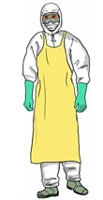

PPE for COVID-19
Medical mask (triple layer)
Coveralls/Gown; Apron
Gloves
Eye protection (goggles or face shield)
Respirator N95 or FFP2 standard, or equivalent
Heavy duty gloves & Boots or closed work shoes (for cleaners)
Shoe covers
WHO Recommended PPE during COVID-19 outbreak
https://apps.who.int/iris/bitstream/handle/10665/331498/WHO-2019-nCoV-IPCPPE_use-2020.2-eng.pdf
(Table 1)
MoHFW COVID-19 Guidelines on rational use of PPE
Section 5: PPEs to be used in different settings
https://www.mohfw.gov.in/pdf/GuidelinesonrationaluseofPersonalProtectiveEquipment.pdf

Slide 10


Gloves
To reduce the risk of
  contamination of healthcare workers’ hands
  germ dissemination to the environment and transmission from healthcare worker to the patient and vice versa, as well as from one patient to another
Wear: when touching blood, body fluids, secretions, excretions, mucous membranes, non-intact skin
Change:
  between tasks and procedures on the same patient
  after contact with potentially infectious material.
Remove:
  after use
  before touching non-contaminated items and surfaces,
  before going to another patient
- Sterile, single-use gloves
- Heavy duty gloves
Perform hand hygiene immediately after removal

Slide 11
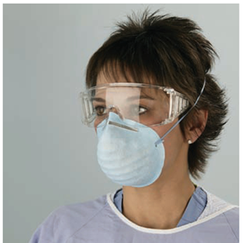
Facial Protection
(Eyes, Nose and Mouth)
Wear
A surgical or procedure mask and eye protection (eye visor, goggles) or
A face shield to protect mucous membranes of the eyes, nose, and mouth
during activities that are likely to generate splashes or sprays of blood, body fluids, secretions, and excretions when touching blood, body fluids, secretions, excretions, mucous membranes, non-intact skin

Slide 12
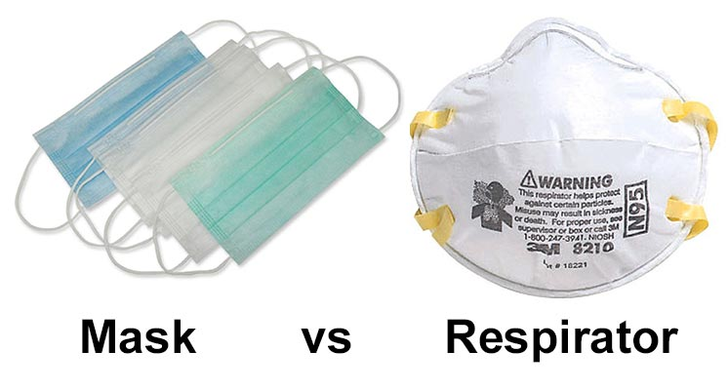
Masks
Medical masks for
  Health care workers providing direct care to COVID-19 patients and/or other patients
  Lab technicians
  Hospital staff in screening area
  Cleaners/Helpers
  Ambulance and patient transfer staff
  Mortuary Staff and those handling bodies
  Patients with respiratory symptoms
Respirator N95 or FFP2 or equivalent standard
  Specifically, for HCW while performing aerosol-generating procedures (e.g. tracheal intubation, non-invasive ventilation, tracheostomy, cardiopulmonary resuscitation, manual ventilation before intubation, bronchoscopy)
  Used for an extended time- wearing the same respirator while caring for multiple patients who have the same diagnosis without removing it

Slide 13
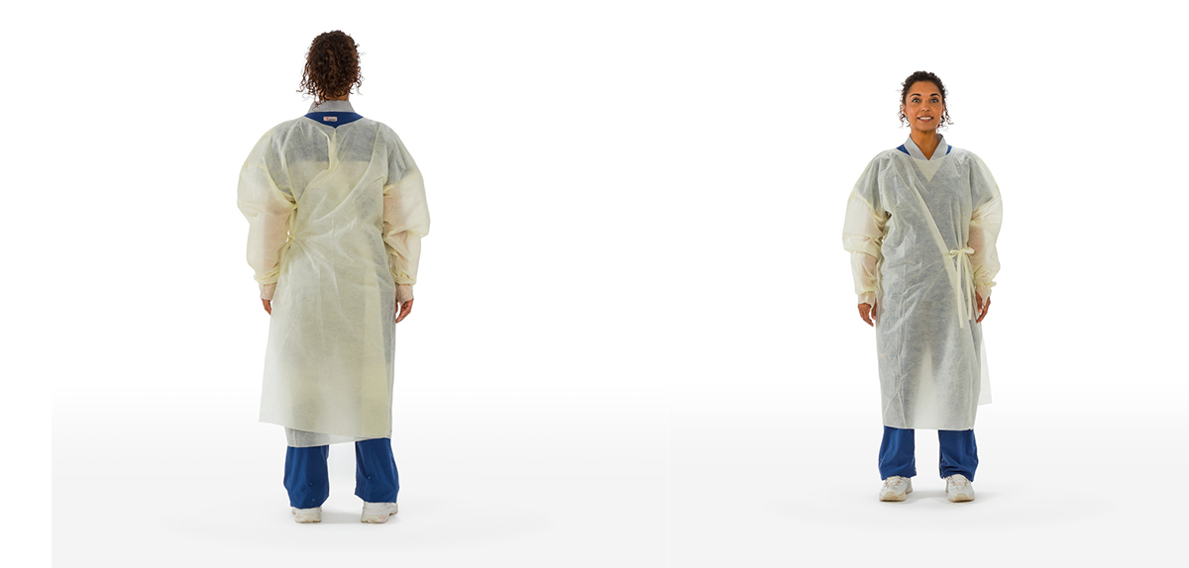
Gown
Wear
to protect skin and prevent soiling of clothing during activities that are likely to generate splashes or sprays of blood, body fluids, secretions, or excretions
Remove
soiled gown as soon as possible, and perform hand hygiene

Slide 14
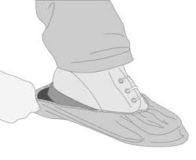
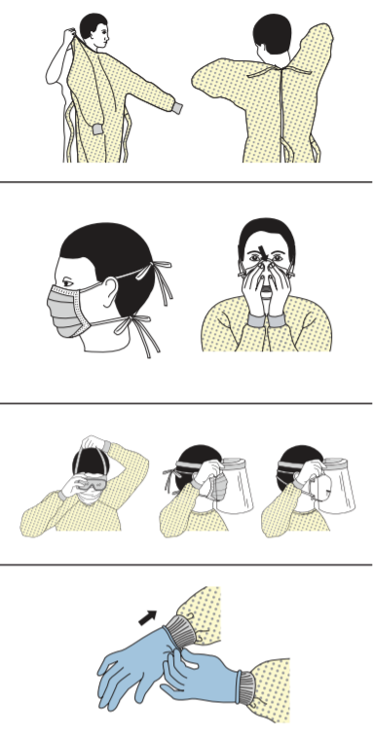
Donning PPE
1. SHOE COVER
  Sit on a Chair
  Pull the cover onto each shoe
  Do not touch the floor or other areas while wearing shoe covers
  Disinfect hands
  2. GOWN
  Fully cover torso from neck to knees, arms to end of wrists, and around the back.
  Fasten in back of neck and waist
1
2
3. MASK OR RESPIRATOR
  Secure ties or elastic bands at middle of head and neck
  Fit flexible band to nose bridge
  Fit snug to face and below chin
  Fit-check respirator
4. GOGGLES OR FACE SHIELD
  Place over face & eyes, adjust to fit
  Band of the goggles should be placed over the headgear
3
4
5. HAND GLOVES
  Last PPE to be donned
  Hold the glove at upturned part, roll it over palm
  Pull till the cuff of the gown, then roll it down
  Repeat the same for the other hand
  Stretch and lock fingers to check for fitting
CDC
https://www.cdc.gov/hai/pdfs/ppe/ppe-sequence.pdf
5

Slide 15
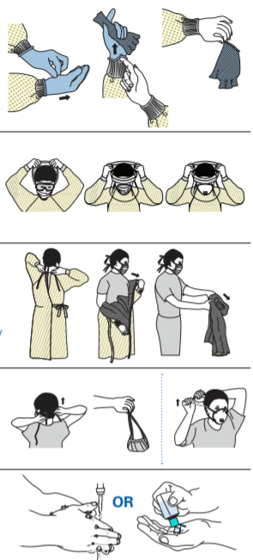
Doffing PPE
1
1. SHOE COVER
• Grasp outside of the shoe cover and pull it down over the heel, repeat for the second shoe cover
2. GLOVES (Outside of gloves are contaminated!)
• If your hands get contaminated during glove removal, immediately wash your hands or use an alcohol-based hand sanitizer
• Using a gloved hand, grasp the palm area of the other gloved hand and peel off first glove
• Hold removed glove in gloved hand
• Slide fingers of ungloved hand under remaining glove at wrist and peel off second glove over first glove
• Discard gloves in a waste container
2
3. GOGGLES OR FACE SHIELD (Outside of goggles or face shield are contaminated!)
If your hands get contaminated during goggle or face shield removal, immediately wash your hands or use an alcohol-based hand sanitizer
Remove goggles or face shield from the back by lifting head band or ear pieces
If the item is reusable, place in designated receptacle for reprocessing. Otherwise, discard in a waste container
3
4. GOWN (Gown front and sleeves are contaminated!)
If your hands get contaminated during gown removal, immediately wash your hands or use an alcohol-based hand sanitizer
Unfasten gown ties, taking care that sleeves don’t contact your body when reaching for ties
Pull gown away from neck and shoulders, touching inside of gown only
Turn gown inside out
Fold or roll into a bundle and discard in a waste container
5. MASK OR RESPIRATOR (Front of mask/respirator is contaminated — DO NOT TOUCH!)
If your hands get contaminated during mask/respirator removal, immediately wash your hands or use an alcohol-based hand sanitizer
Grasp bottom ties or elastics of the mask/respirator, then the ones at the top, and remove without touching the front
Discard in a waste container
4
5
6. Wash Hands or Use an Alcohol-based Hand Sanitizer after removing all PPE
Take a Shower after removing the PPE
CDC
https://www.cdc.gov/hai/pdfs/ppe/ppe-sequence.pdf
6

Slide 16


Donning PPE
Doffing PPE
Acknowledgement: The videos have been recorded by Armed Forces Medical College (AFMC), Pune for knowledge of Healthcare Workers dealing with COVID-19

Slide 17
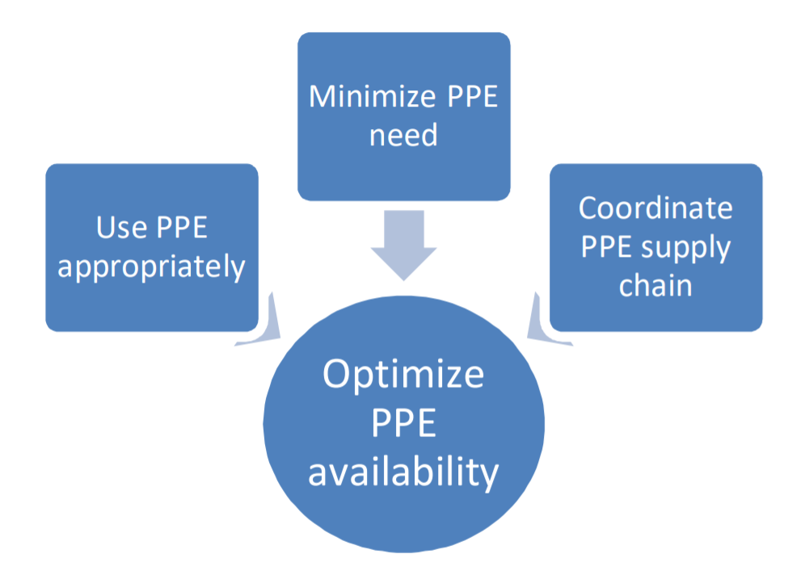
Rational Use of PPE
Strategies to optimize the availability of personal protective equipment (PPE)
Consider using telemedicine, where possible
Use physical barriers to reduce exposure to the COVID-19 virus
Restrict number of healthcare workers from entering the rooms of COVID-19 patients
Use PPE according to the setting and type of personnel and activity:
Healthcare Workers
Persons with respiratory symptoms
Persons without symptoms
Management of PPE should be coordinated through essential national and international supply chain management mechanisms
Source: WHO, MoHFW

Slide 18
Environmental cleaning and disinfection

Slide 19

Cleaning Agents and Disinfectants
1% Sodium Hypochlorite can be used as a disinfectant for cleaning and disinfection
The solution should be prepared fresh
Leaving the solution for a contact time of at least 10 minutes is recommended.
Alcohol (e.g. isopropyl 70% or ethyl alcohol 70%) can be used to wipe down surfaces where the use of bleach is not suitable, e.g. metals.
Soure: MoHFW

Slide 20
Environmental Cleaning
Cleaning and disinfecting environmental surfaces is fundamental in reducing healthcare-associated infections
Microbiologically contaminated surfaces can serve as reservoirs of potential pathogens. Transfer of microorganisms from environmental surfaces to HCWs/patients is mostly via hand contact with the surface
COVID-19 virus can potentially survive in the environment for several hours/days. Premises and areas potentially contaminated with the virus to be cleaned before their re-use
As per MoHFW, all surfaces of the isolation area (floors, bed, railings, side tables, IV stand, etc.) should be wiped with 1% Sodium Hypochlorite solution; allow a contact time of 30 minutes, and then allowed to air dry
Cleaning staff must be provided with required PPE
ROUTINE ENVIRONMENTAL CLEANING
Frequently Touched Surfaces
Minimally Touched Surfaces
Doorknobs
Bedrails
Light switches
Wall areas around the toilet in the patient’s room
Edges of privacy curtains
Floors
Ceilings
Walls
blinds
Soure: MoHFW

Slide 21
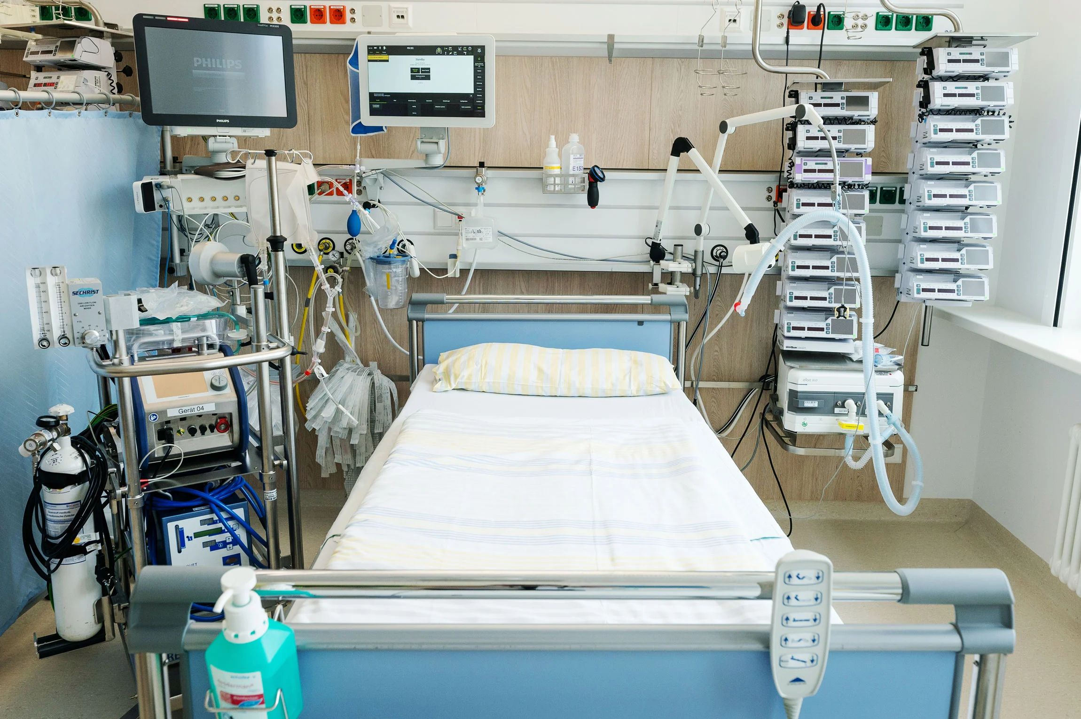
Can You identify the high touch points in this ICU?

Slide 22
Can You identify the high touch points in this ICU?

Slide 23
Cleaning Guidelines for Clinical Area
Area/Item | Process for Disinfection
Floors | Detergent and 1% Sodium Hypochlorite
Ceiling & Walls | Detergent/ 1% Sodium Hypochlorite
Doors & Door Knobs | Detergent/ 1% Sodium Hypochlorite
Isolation room | Detergent and 1% Sodium Hypochlorite
All Clinical Areas/ Laboratories/where spill care is required | 1% Sodium Hypochlorite
Refrigerators | Detergent & Water Inside Cleaning: Weekly Surface Cleaning Schedule: As mentioned for High Touch Surfaces
Equipment (Equipment need to be disinfected after every contact with suspected patient) | All Areas & Surfaces of Equipment: 1% Sodium Hypochlorite Sensitive Probes of Equipment: 70% Alcohol CT/MR like machines etc: As per manufacturer’s Instructions
Infection Prevention & Control Guidelines for
COVID-19
Table 4: CLEANING GUIDELINES FOR CLINICAL AREA
https://www.aiims.edu/images/pdf/notice/COVID_19_HIC_SUPPLEMENT_VERSION_1.2__26_3_20.pdf
Soure: MoHFW

Slide 24
Cleaning and Disinfection of
Medical Equipment
Before removing equipment from patients room, medical equipment must be disinfected
Non-critical medical equipment (E.g., stethoscopes, blood pressure cuffs, dialysis machines and equipment knobs and controls) usually only require cleansing followed by low- to intermediate-level disinfection, depending on the nature and degree of contamination
In absence of manufacturer instructions regarding cleaning/disinfection of equipment
  Ethyl alcohol or isopropyl alcohol (60%–90%, v/v) is to be often used to disinfect small surfaces (rubber stoppers of multiple-dose medication vials, and thermometers) and occasionally external surfaces of equipment (stethoscopes and ventilators)
Cleaning staff must wear gloves when handling and transporting used patient care equipment
Barrier protection
For difficult to clean surfaces and equipment, especially if these surfaces are
•Touched frequently by gloved hands during the delivery of patient care
•Likely to become contaminated with body substances
Use impervious-backed paper, plastic or fluid-resistant covers
Remove and discard coverings with gloved hands
Perform hand hygiene after un-gloving
  Cover these surfaces with clean materials before the next patient encounter
Soure: MoHFW

Slide 25
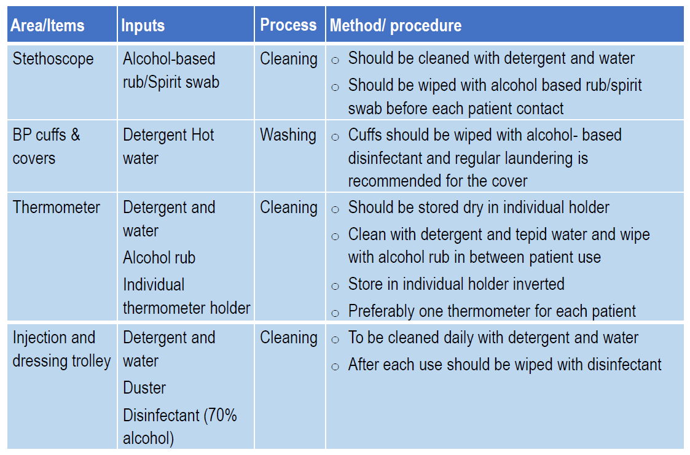
Cleaning and Disinfection of
Medical Equipment
Soure: MoHFW

Slide 26
Cleaning Guidelines for Non-Clinical Area
Area/Item | Process for Disinfection
General cleaning | Detergent and Water (1% Sodium Hypochlorite can be done)
Lockers/ Tables/Cupboards/ Wardrobes/ Benches/ Shelves | Detergent & Water
Railings | Detergent & 1% Sodium Hypochlorite Three small buckets: One with plain water One with detergent solution One for sodium hypochlorite 1%
Mirrors & Glass | Detergent & Water
Stainless steel/ Any other sink | Detergent & Water
Furniture/Chairs/ Telephone | Detergent & Water
Light Switches | Detergent & Water
Curtains | Detergent & Water
Infection Prevention & Control Guidelines for
COVID-19
Table 5: CLEANING GUIDELINES FOR NON-CLINICAL AREAS
https://www.aiims.edu/images/pdf/notice/COVID_19_HIC_SUPPLEMENT_VERSION_1.2__26_3_20.pdf
Soure: MoHFW

Slide 27
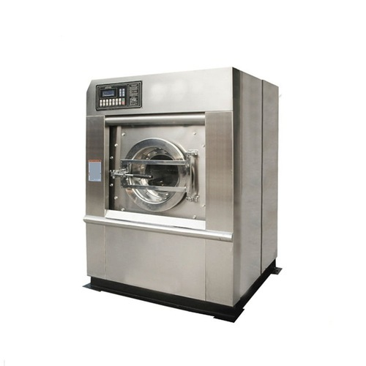
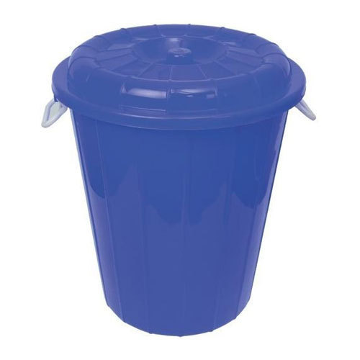
Cleaning and Disinfection of Linen
Handle, transport, and process used linen in a manner which:
  Prevents skin and mucous membrane exposures and contamination of clothing
  Avoids transfer of pathogens to other patients and or the environment
Wear appropriate PPE
Never carry soiled linen against body; place soiled linen in a leak-proof bag or bucket
Any solid excrement to be removed and put in covered bucket to dispose of in the toilet or latrine
Perform hand hygiene after blood/body fluid exposure and after PPE removal
Machine Washing
Wash at 60-90°C with laundry detergent followed by soaking in 1% sodium hypochlorite for approximately 30 minutes and dried
No machine washing
Soak in hot water with soap/detergent in a large drum
Use a stick to stir and avoid splashing
Empty the drum and soak linen in 1% sodium hypochlorite for approx. 30 minutes
Rinse with clean water and let linens dry fully in the sunlight
Soure: MoHFW, Hospital best practices

Slide 28
Cleaning of Toilets
Area/Item | Process for Disinfection | Method
Toilet Pot & Floor | 1% Sodium Hypochlorite | Scrub with the recommended agents and the long handle angular brush
Rest all areas of Toilets like Taps & Fittings Outside Sink Soap Dispensers etc. | Detergent & Water | Scrub
Soure: MoHFW, Hospital best practices

Slide 29
Frequency of Cleaning of Surfaces
HIGH TOUCH SURFACES
LOW TOUCH SURFACES
CLINICAL
AREAS
NON-CLINICAL
AREAS
CLINICAL
AREAS
NON-CLINICAL
AREAS
Where Suspected or Confirmed COVID-19 Case is kept
Other areas, where no Suspected or Confirmed COVID-19 case is kept
Where Suspected or Confirmed COVID-19 Case is kept
Other areas, where no Suspected or Confirmed COVID-19 Case is kept
Every 1-2 hr
Every 2-3 hr
Every 3-4 hr
Every 2-3 hr
Every 3-4 hr
Once Per Shift
Soure: MoHFW

Slide 30
Bio-medical waste (BMW) management

Slide 31
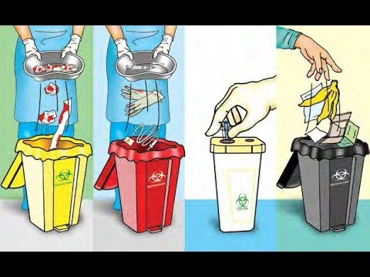
Bio-Medical Waste Management for COVID-19
  Specific guidelines to be followed by all the stakeholders including isolation wards quarantine centers, sample collection centers, laboratories, ULBs (Urban Local Bodies) and common bio-medical waste treatments and disposal facilities, in addition to existing practices under BMW management Rules, 2016
  Guidelines brought out by WHO, MOHFW, ICMR and other concerned agencies from time to time may also be referred
Soure: MoHFW

Slide 32
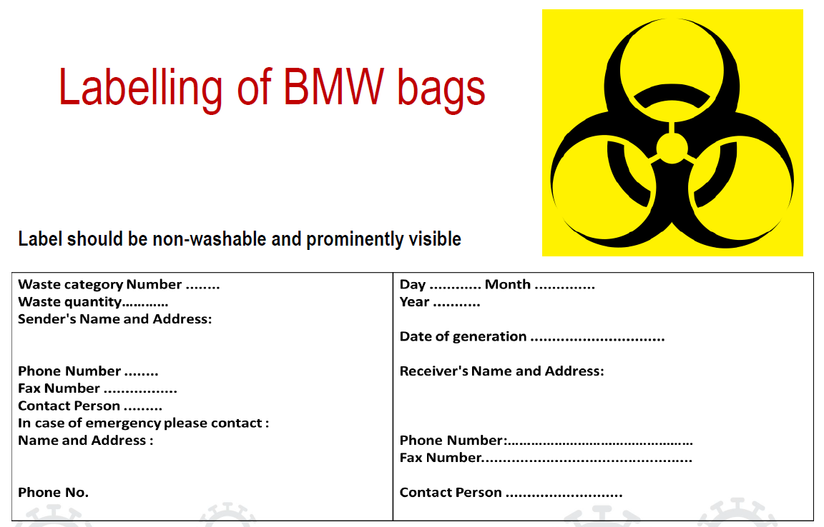
Bio-Medical Waste Management for COVID-19
  A. COVID-19 Isolation Wards:
  - Keep separate color coded bins/bags/containers in wards and maintain proper segregation of waste as per BMW Management Rules, 2016 as amended and CPCB (Central Pollution Control Board) guidelines
  - As precaution use double layered bags (using 2 bags) for collection of waste from COVID-19 isolation wards to ensure adequate strength and no-leaks
  Collect and store biomedical waste separately prior to handling over to CBWTF (Common Bio-medical Waste Treatment and Disposal Facility)
  Use dedicated collection bin labelled as “COVID-19” to store COVID-19 waste (in addition to mandatory labelling) and keep separately in temporary storage room prior to handling over to authorized staff of CBWTF
  - Dispose General waste not having contamination as solid waste as per Solid Waste Management Rules, 2016
  Maintain separate record of waste generated from COVID-19 isolation wards
  - Disinfect (inner and outer) surface of containers/bins/trolleys used for storage of COVID-19 waste with 1% sodium hypochlorite solution
  - Depute dedicated sanitation workers separately for BMW and general solid waste
Soure: MoHFW

Slide 33
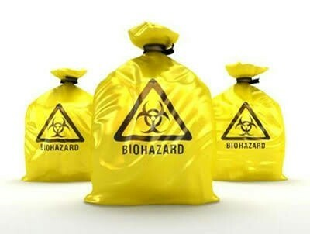
Bio-Medical Waste Management for COVID-19
  B. Sample collection centers and laboratories for COVID-19 suspected patients
  Report opening or operation of COVID-19 sample collection centers and laboratories to concerned SPCB.
  Follow guidelines given for isolation wards
  C. Quarantine Camps/Home care for COVID-19 suspected patients
  Less quantity of biomedical waste is expected from quarantine centers.
  Treat the routine waste as general solid waste and dispose off as per SWM rules, 2016.
  Biomedical waste, if any, generated from quarantine centers/camps should be collected separately in yellow coloured bags and bins
  - Inform CBWTF operators as and when the waste is generated for collection for treatment and disposal at CBWTFs
  - In case of home-care for suspected patients, collect biomedical waste separately in yellow bags and hand over to authorized waste collectors engaged by local bodies. ULB should engage CBWTFs to pick-up such waste either directly from such quarantined houses or from identified collection points
Soure: MoHFW

Slide 34
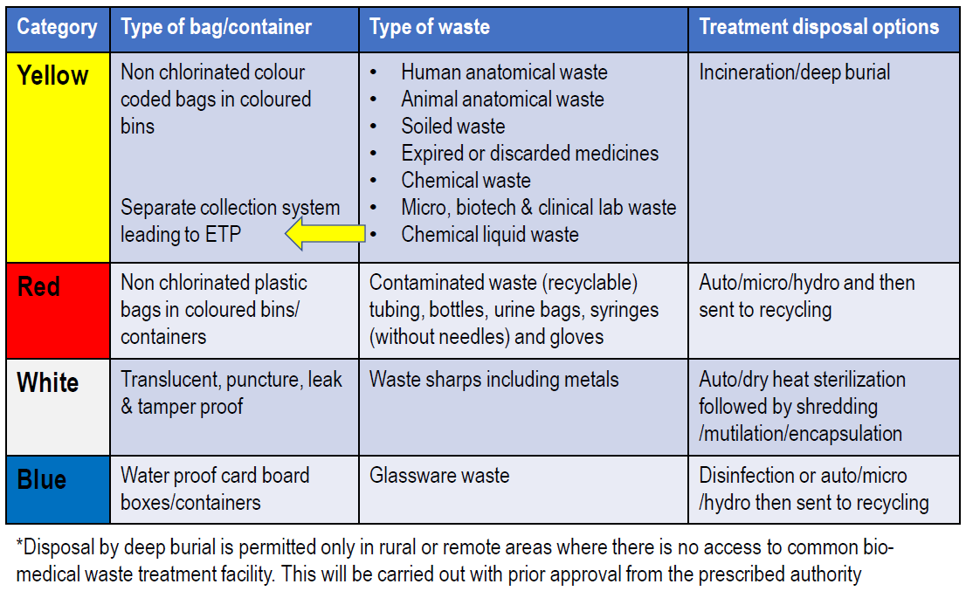
Disposal of BMW
Soure: MoHFW

Slide 35
Other Standard Precautions: Accidental exposure to blood or body fluids
  Per-cutaneous injury or muco-cutaneous exposure to blood or body fluids
    injured or exposed areas should be washed with copious amount of water
  Percutaneous or mucocutaneous exposure
    should be reported to the supervisor
    injured person should immediately seek medical advice for proper wound care and post-exposure management

Slide 36
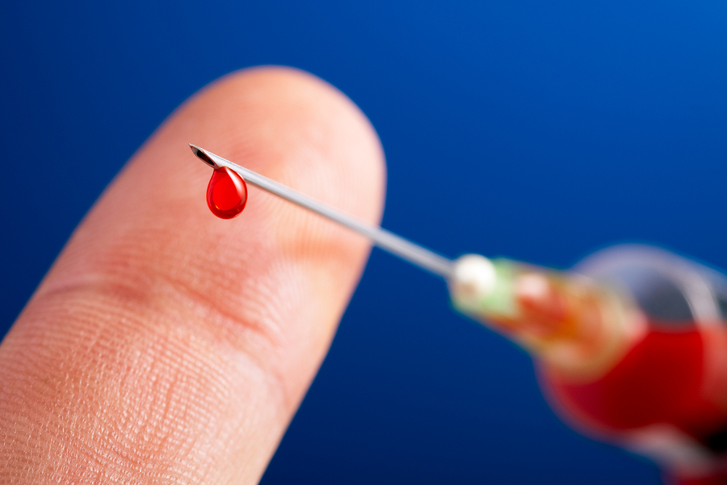
Other Standard Precautions: Prevention of needle stick and injuries from other sharp instruments
Use care when:
Handling needles, scalpels, and other sharp instruments or devices.
Cleaning used instruments.
Disposing of used needles and other sharp instruments.

Slide 37
Completed:
Infection Prevention and Control (IPC)
Next
Clinical Management

Slide 38
NEXT – Clinical Management

