Slide 1
E-learning Course for Healthcare Workers on COVID-19
(Novel Coronavirus) Outbreak

Slide 2
Course Outline
Module 1: Introduction to COVID-19
Types of Coronavirus
About COVID-19
How it spreads
Symptoms
Basic Screening and provision of testing
Home Quarantine and Isolation
Basic Administrative Measures
Module 2: Infection Prevention and Control
What are standard precautions
When and How to do hand hygiene
When and how to wear masks
When and how to wear gloves
When and how to wear goggles or face shields
Donning and Doffing standard PPE
Rational use of PPE
Bio-Waste Management
Module 3: Clinical Management

Slide 3
Module 1: Introduction
Coronavirus and COVID-19

Slide 4
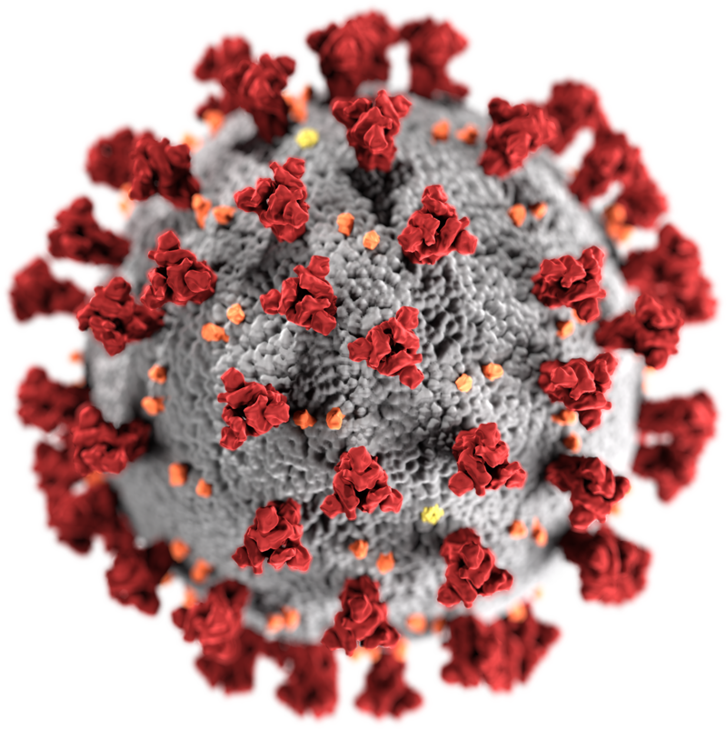
About Coronaviruses (CoV)
Enveloped positive sense (+) single stranded (ss) RNA viruses, named for the crown-like spikes on their surface
Belong to a large family, cause illness ranging from common cold to more severe diseases
Human coronaviruses were first identified in the mid-1960s. Seven coronaviruses can infect people
Sometimes coronaviruses that infect animals can evolve and make people sick and become a new human coronavirus, for e.g.
SARS-CoV: emerged in 2003 in southern China
MERS-CoV: emerged in 2012 in Saudi Arabia
SARS-CoV-2: emerged in December 2019 in China
Picture Credit: Content Provider(s): CDC/ Alissa Eckert, MS; Dan Higgins, MAM - This media comes from the Centers for Disease Control and Prevention's Public Health Image Library(PHIL), with identification number #23312.
Source: WHO and CDC

Slide 5
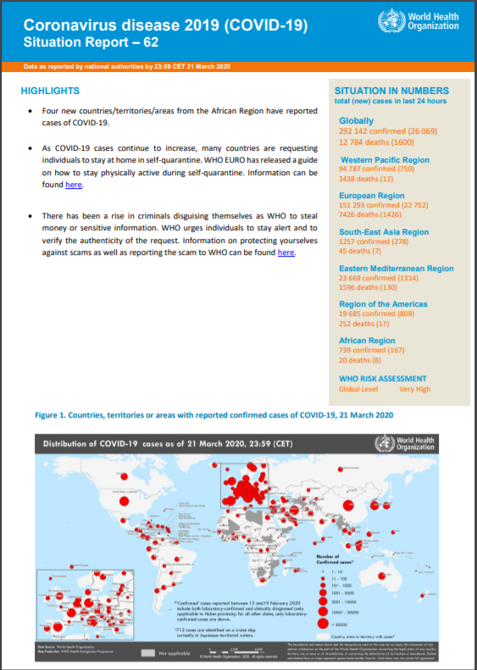
About COVID-19
An infectious disease caused by a newly discovered coronavirus- SARS-CoV-2
Declared as a Pandemic by WHO on 11th March 2020
At this time, there are no specific vaccines or treatments for COVID-19. However, there are many ongoing clinical trials evaluating potential treatments
Incubation period ranges from 1 to 14 days with a median of about 5 - 6 days, based on the available data
Most people experience mild to moderate respiratory illness and recover without requiring special treatment
Older people, and those with underlying medical problems like cardiovascular disease, diabetes, chronic respiratory disease, cancer and immunocompromised conditions are more likely to develop serious illness
Coronavirus disease (COVID-2019) situation reports by WHO:
https://www.who.int/emergencies/diseases/novel-coronavirus-2019/situation-reports
Source: WHO, MOHFW

Slide 6
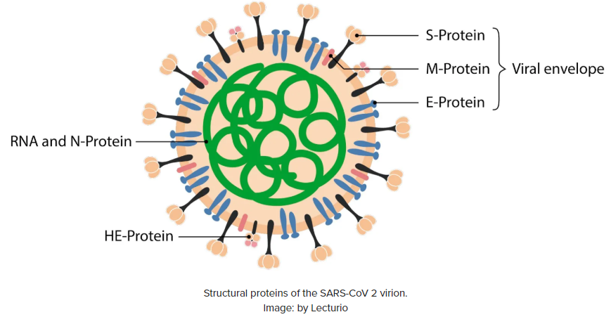
Transmission of COVID-19- How it Spreads?
Zoonotic transmission (from animals to humans)
Human-to-human transmission
SARS-CoV-2 binds, via its Spike (S) protein, to host cell through angiotensin-converting enzyme 2 (ACE2) and basigin (BSG)
ACE 2 is expressed by epithelial cells of the intestine, kidney, blood vessels, and most abundantly in type II alveolar cells of the lungs
Once in human, the virus is transmitted mainly via direct hand-to-face contact and inhalation of aerosol (suspension of fine solid particles or liquid droplets in air)/ droplets from the coughing or sneezing of infected individuals
As per WHO, transmission is also possible through surface or object containing the virus and then touching mouth, nose, or face
Source: WHO

Slide 7
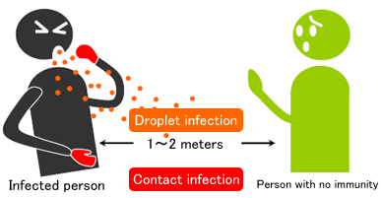
Transmission of COVID-19- How it Spreads?
Human-to-human transmission (Contd.)
SARS-CoV-2 is highly contagious due to the production of high viral loads and efficient shedding of virions from the upper respiratory tract
Droplets typically do not travel more than 6 feet (about 2 metres) from the infected individual, but can remain viable in the air for up to 3 hours under optimum conditions
Infectious period ranges from 2 days before the onset of symptoms up to 2-3 days after their resolution
Asymptomatic individuals are also contagious, but to a lesser degree
Number of secondary infections generated from 1 infected individual, is between 2 and 2.5, higher than for Influenza. This is called the R0

Slide 8
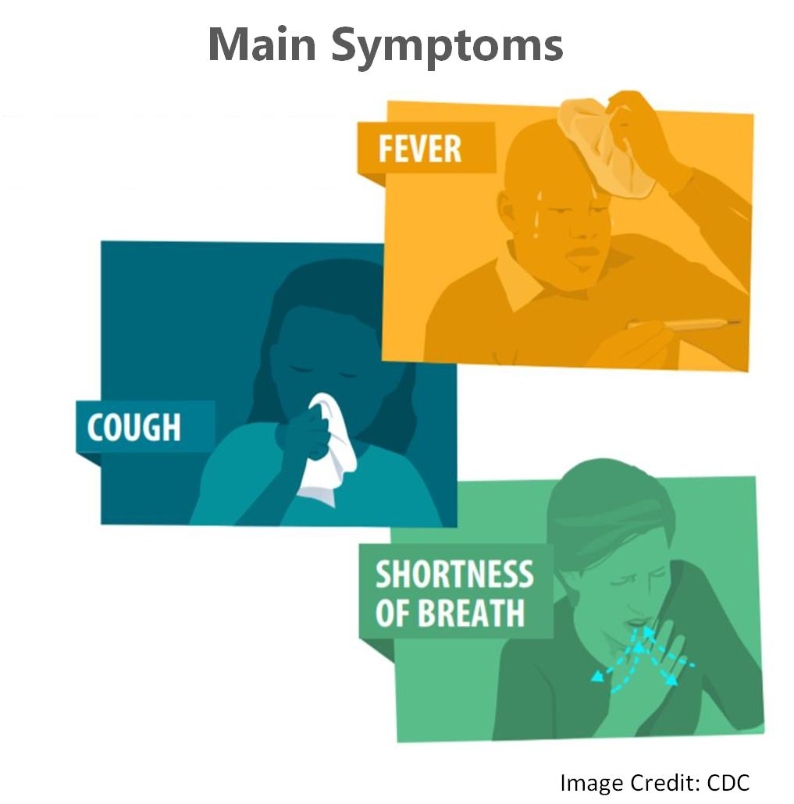
Symptoms
The illness seems to start with a fever, followed by a cough, and then followed by a shortness of breath and some other respiratory symptoms like stuffy nose, weakness or malaise, nausea, vomiting, diarrhoea, or headaches
Emergency warning signs for COVID-19 demanding immediate medical attention, include:
Trouble breathing
Persistent pain or pressure in the chest
New confusion or inability to arouse
Bluish lips or face
Other symptoms that are severe or concerning
Source: MOHFW, CDC

Slide 9
Who is a Suspected Case of COVID-19?
A patient with
acute respiratory illness {fever and at least one sign/symptom of respiratory disease (e.g., cough, shortness of breath)},
AND
a history of travel to or residence in a country/area or territory reporting local transmission of COVID-19 disease during the 14 days prior to symptom onset
A patient/Health care worker with
any acute respiratory illness
AND
having been in contact with a confirmed COVID-19 case in the last 14 days prior to onset of symptoms
A patient with
severe acute respiratory infection {fever and at least one sign/symptom of respiratory disease (e.g., cough, shortness breath)}
AND
requiring hospitalization
AND
with no other etiology that fully explains the clinical presentation
OR
OR
Source: MOHFW

Slide 10
Setting Up of Triage Area
A well-equipped triage station at the entrance to the facility, separate from the other areas supported by trained staff
The HCWs must be instructed to maintain a very High Index of Suspicion
HCW to use screening questionnaires according to the updated case definition (from NCDC)
The health workforce should be provided all Personal Protective Equipment (PPE)
Post signs in public areas reminding symptomatic patients to alert HCWs
Offer a medical mask to patients with suspected COVID-19 while they are in waiting/public areas or in cohorting rooms
Evaluate family members of suspected patients for possibility of infection
The patients should have access to material for respiratory hygiene like masks, tissue papers with adequate proper disposal facility thereof.
Source: WHO

Slide 11
Sample Algorithm for Management of Suspected COVID-19 cases
SCREEN – ISOLATE -TRANSFER
All Patients with Fever and Cough arriving at OPD
At Hospital Entrance
Screening desk to be placed at the main entrance of the hospital lobby
It will be manned by nurse who will screen (wearing PPE)
H/O fever and cough/difficulty in breathing AND history of travel or Close Contact with suspected/ probable/ confirmed case of COVID 2019
Temp with Infra-Red Thermometer
Respiratory/Flu Clinic (with separate entrance and Registration desk)
Screening by dedicated nurse in Respiratory/Flu Clinic
H/O fever and cough/difficulty in breathing AND history of travel or Close Contact with suspected/ probable/ confirmed case of COVID 2019
Temp with Infra-Red Thermometer, vitals
Spo2 with finger monitor
Give mask to patient
Not a Suspected Case
If patient has flu like symptom with no H/O travel or contact- will be given surgical mask & will be guided to Respiratory/ Flu Clinic
Suspected Case
Nurse to fill screening form
Referral to identified hospital along with screening form
For shifting to COVID-19 Authorized Hospital
Call CATS ambulance (preferable)
Can take in own car
Avoid public transport
While patient is awaiting transfer, isolate near screening desk
Safe Transfer PPE
Not a Suspected Case
Send to Doctor in Respiratory / Flu Clinic
Treatment as per patients clinical requirement
Suspected Case
Nurse to fill screening form
Send to Doctor in Respiratory/Flu Clinic
Referral to identified hospital
Source: Protocols from various hospitals

Slide 12
Screening for COVID-19
Key requirements in triage or screening area
In Health Care Facilities
Conduct timely and effective TRIAGE (assignment of degree of urgency) for early identification of patients with acute respiratory infection (ARI) to prevent the transmission of pathogens to health care workers and other patients
Prioritize isolation and care of symptomatic patients
Prevent Overcrowding. Maintain a separate Flu-clinic for all patients coming with flu-like symptoms
Keep at least 1 meter distance between suspected patients and other patients
Instruct all patients to cover nose and mouth during coughing or sneezing with tissue or flexed elbow
Screening questionnaire​
Algorithm for triage​
PPE​ (Personal Protective Equipment)
Hand hygiene supplies
Infrared thermometer​
Cleaning/disinfection​​ supplies
Source: WHO

Slide 13
Screening of Visitors and Close Contacts
Screening of visitors and close contacts of a confirmed case should also be done
All high risk contacts of a confirmed case
if asymptomatic: should be put under home quarantine for at least 28 days.
if symptomatic: should be lab tested for COVID-19
Source: MOHFW

Slide 14
Sample Collection and Testing
Current Testing Strategy:
All asymptomatic individuals who have undertaken international travel in the last 14 days, if they become symptomatic for COVID-19
All symptomatic contacts of laboratory confirmed cases
All symptomatic health care workers
All hospitalized patients with Severe Acute Respiratory Illness (fever AND cough and/or shortness of breath)
Asymptomatic direct and high-risk contacts of a confirmed case should be tested once between day 5 and day 14 of coming in his/her contact
Lab test can be offered when prescribed by physician as per ICMR Guidelines for COVID-19 testing
Currently, only hospitals and collection centres authroised by ICMR can collect samples for suspected cases of COVID-19
Samples are to be tested only in ICMR designated labs
On 21st March, ICMR announced that approved private labs can conduct the tests for COVID-19
ICMR guidance evolves periodically and can be accessed at https://icmr.nic.in/content/covid-19
Source: ICMR

Slide 15
Home Quarantine
Appropriate for patients with mild infection who can be adequately isolated in the outpatient setting
Patients should be advised to
stay at home and try to separate themselves from other people in the household
wear a facemask when in the same room (or vehicle) as other people and when presenting to healthcare settings
Caregivers should ensure regular disinfection of frequently touched surfaces by the patient
MoHFW Guidelines for home quarantine
https://www.mohfw.gov.in/DraftGuidelinesforhomequarantine.pdf
Source: MoHFW

Slide 16
Setting up Isolation Facility
Set-up one single large COVID-19 dedicated facility at each location and preferably at a newer construction
Newly constructed hospitals/newly constructed wings of hospitals should be considered for conversion to COVID-19 isolation facility
Logistically simpler to manage manpower, supplies, disinfection and waste management
Select facilities positioned away from densely populated areas of the city
Triage area must be right next to the admission facility so possibility of cross infection is minimized
Disinfection of these facilities must be done rigorously and repeatedly as per protocol
Commonly available room air-purifiers with HEPA filters (used for air-pollution) may be placed alongside beds to remove viral load from the air and thereby reduce chances of cross infection
Source: WHO

Slide 17
Basic Administrative Measures
Prevent overcrowding, especially in OPDs/ Pharmacies/Emergency Departments
Separate/alternative provision for OPD patients should be considered
A separation of at least 1 meter should be maintained between all patients
Plan a safe flow of patients, to help prevent transmission of ARI-causing pathogens
Provide health services targeting uninfected populations in a separate facility
Provide dedicated waiting areas for symptomatic patients
Ensure adequate supplies of quality PPE with N-95 or better respirators
Ensure strict adherence to IPC policies and procedures for all aspects of health care
Source: WHO

Slide 18
Basic Administrative Measures: Surge Management
Plan for surge capacity according to the estimated impact of a potential pandemic on health care
Identify the supplies and infrastructures needed to implement IPC measures.
Outline the limits of the health-care facility’s surge capacity and suggest thresholds at which alternative sites for provision of health care
Outline surge capacity in relation to
Supplies (e.g. pharmaceuticals and PPE);
Ventilators and supplemental oxygen
Staff – develop plans to maintain sufficient personnel to carry out activities (e.g. by planning alternative shifts or staffing assignments, and having a supplemental staffing plan)
Infrastructure and Space
Laboratory and diagnostic capacity
Security policies to handle an unexpected increase in demand for services
Source: WHO

Slide 19
Basic Administrative Measures: Limiting HCW Exposure
Develop strong assessment, reporting and management channels to assess HCWs for potential infection upon exposure and rapid treatment facilities for the same
Organize health-care workers into groups designated for caring for patients
Check temperature of each HCW regularly (e.g. before and after each work shift)
Monitor HCW for symptoms of infection (cough, sore throat and difficulty in breathing) for 7–10days after last possible exposure to a patient with a patient of potential concern
Advise workers to take the following actions if they develop a fever >38°C or symptoms of infection
Stop work immediately or do not report to work
Limit interactions with others
Exclude themselves from public areas
Notify management or the team dealing with IPC
Source: WHO

Slide 20
Ministry of Health and Family Welfare Role of Frontline Health Workers in COVID-19
https://www.mohfw.gov.in/pdf/PreventionandManagementofCOVID19FLWEnglish.pdf
https://www.mohfw.gov.in/pdf/PreventionandManagementofCOVID19FLWHindi.pdf
Source: MOHFW

Slide 21
Completed:
Introduction
Next Topic
Infection Prevention and Control

Slide 22
Next Topic
Infection Prevention and Control

